Slide 1
Smart Mirror
20153208
이소영

Slide 2
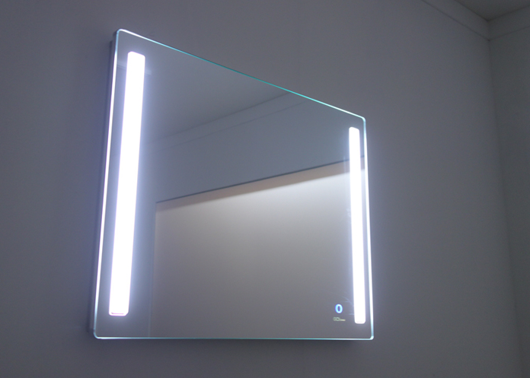
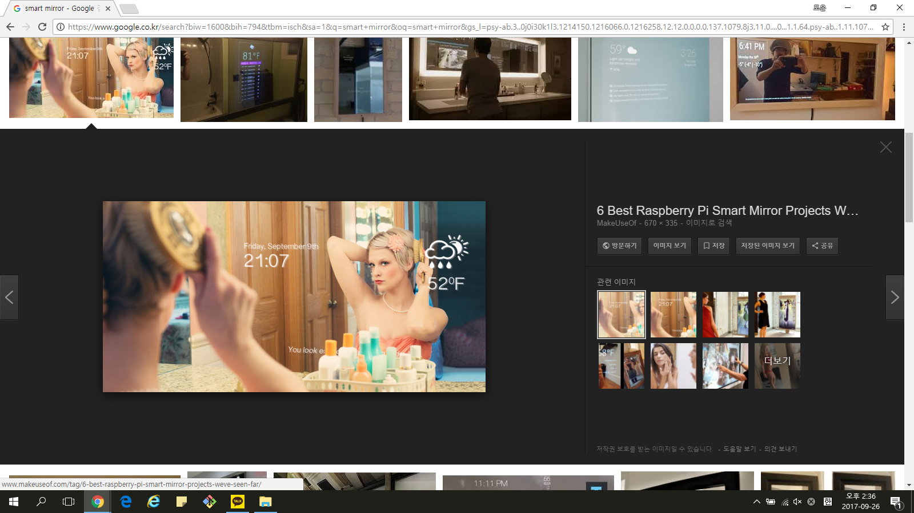
Design
Function
Mirror is to display monitor
The mirror is show that time, date , weather ,etc…..
We can control the mirror through voice recognition.
Time reminder and smart phone status display via mirror
List of required sensors and actuators
Raspberry Pi , LCD monitor , Clear glass , Mirror film, Wifi dongle, Usb microphone , etc….
Benefit
It is effective for time management because it can confirm the time even while watching the mirror and preparing.

